Slide 1
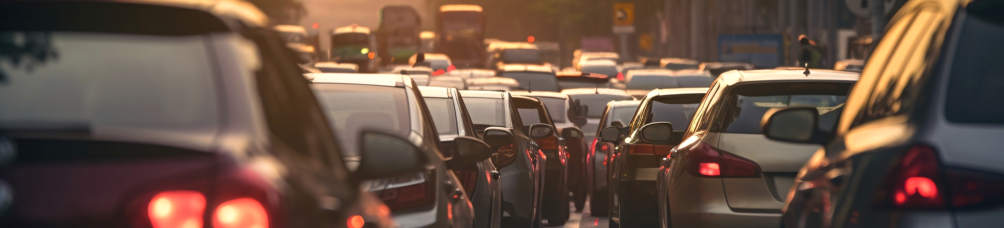
Visualizing Urban Traffic Patterns:
Insights from Bangalore's Traffic Data

Slide 2
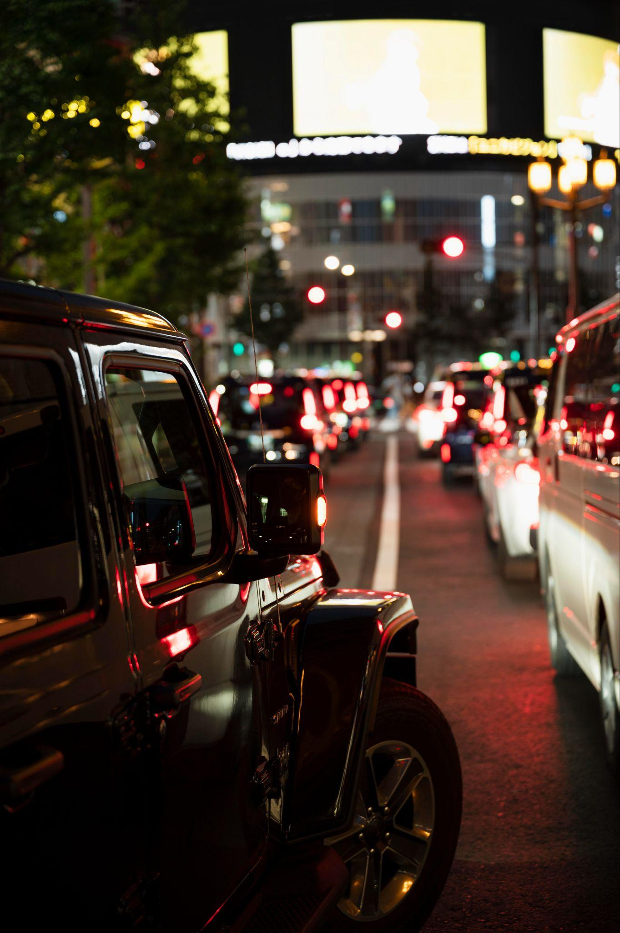
Why transportation?

Slide 3
Dataset Overview
Dataset Source | Bangalore Traffic Dataset
About the data set | This dataset captures detailed traffic patterns across major roads and intersections in Bangalore. It includes multiple metrics providing a comprehensive view of the city's transportation dynamics. Ideal for urban planners and smart city applications.
Fields | Temporal: Date, Month, Year Traffic Metrics: Traffic Volume, Average Speed, Congestion Level, Travel Time Index Behavior & Events: Incident Reports, Traffic Signal Compliance, Roadwork Activity, Weather Conditions Environmental & Social: Environmental Impact, Public Transport Usage, Pedestrian and Cyclist Count
Records | 8936

Slide 4
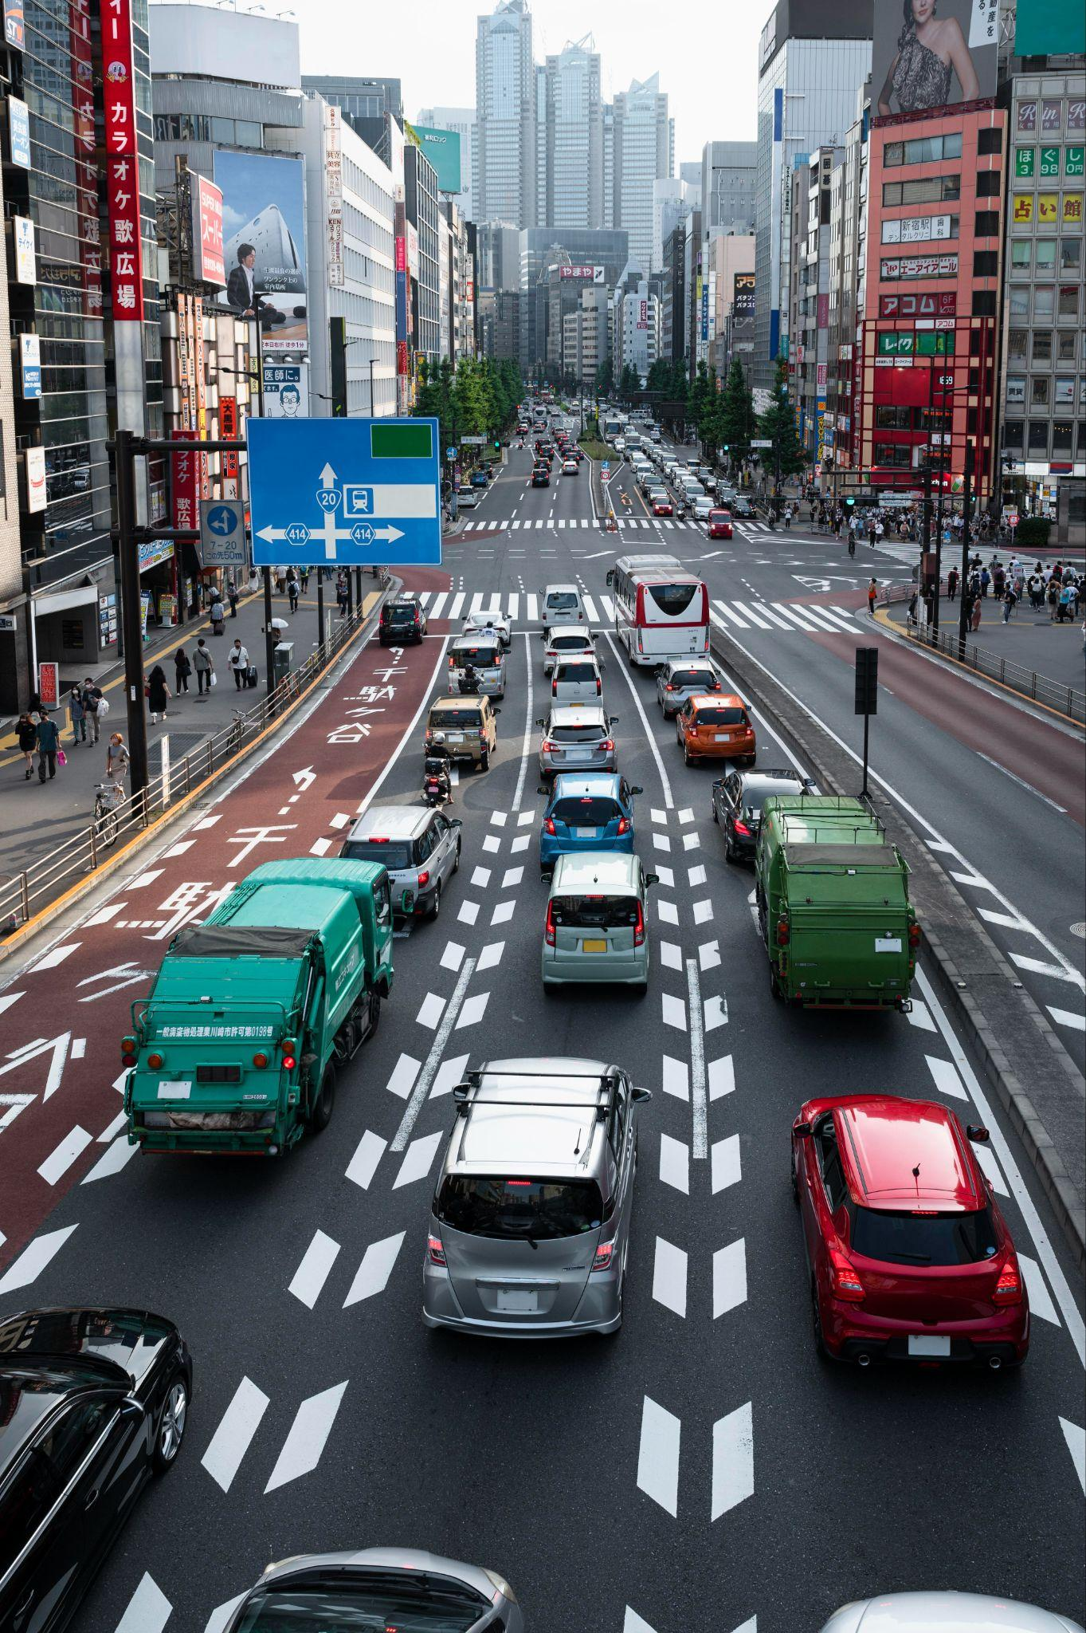
Goal
Build an interactive app to explore traffic patterns and investigate factors impacting congestion and travel time.

Slide 5

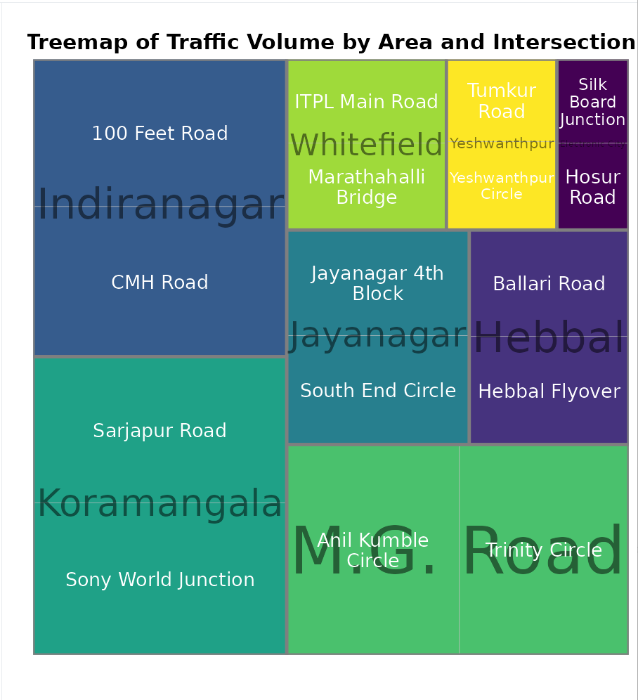
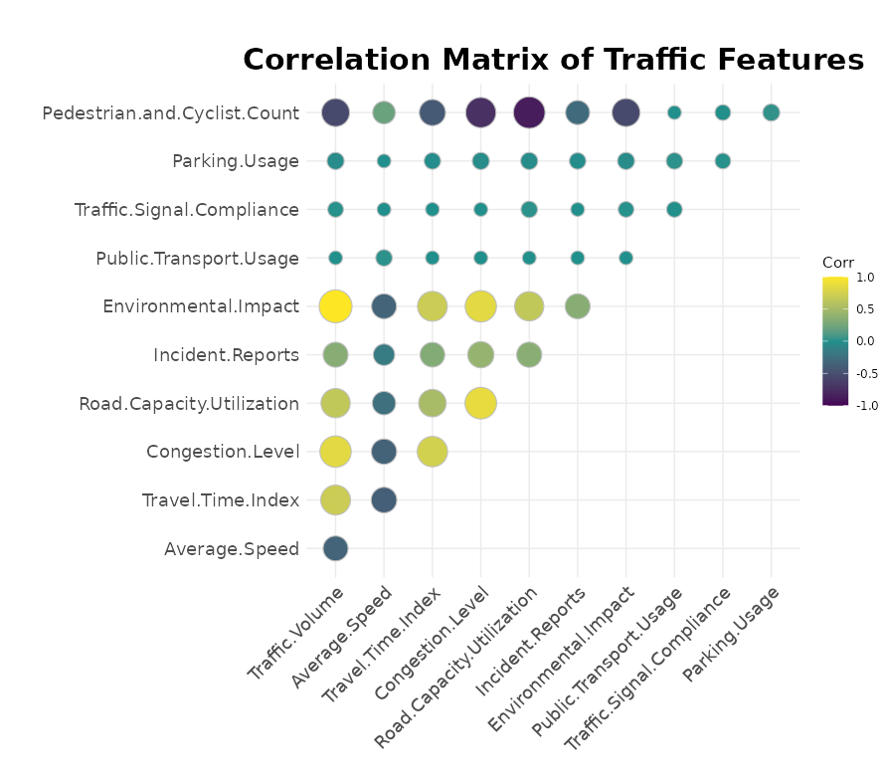
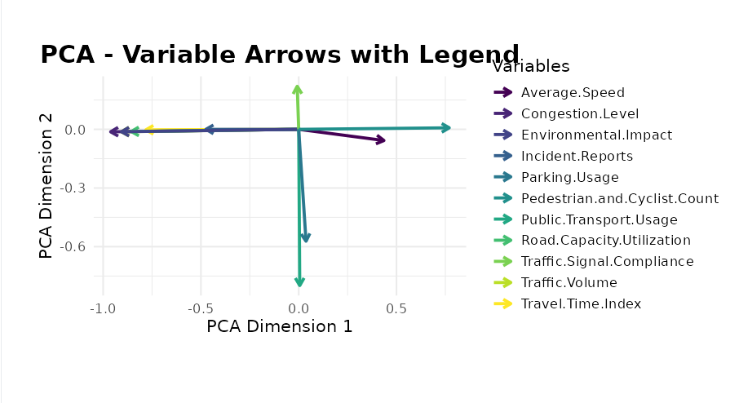
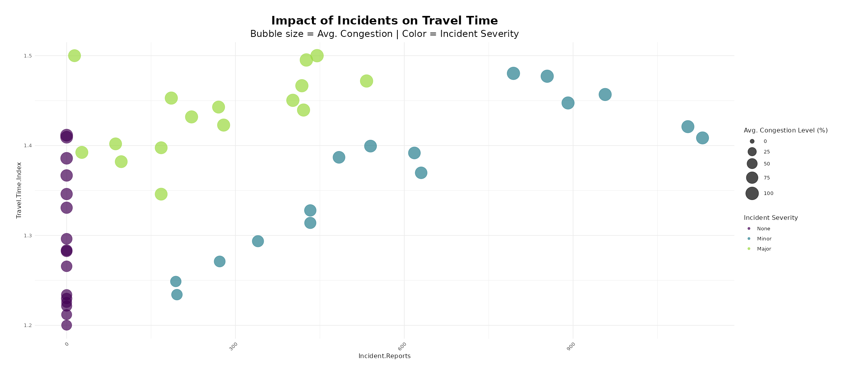
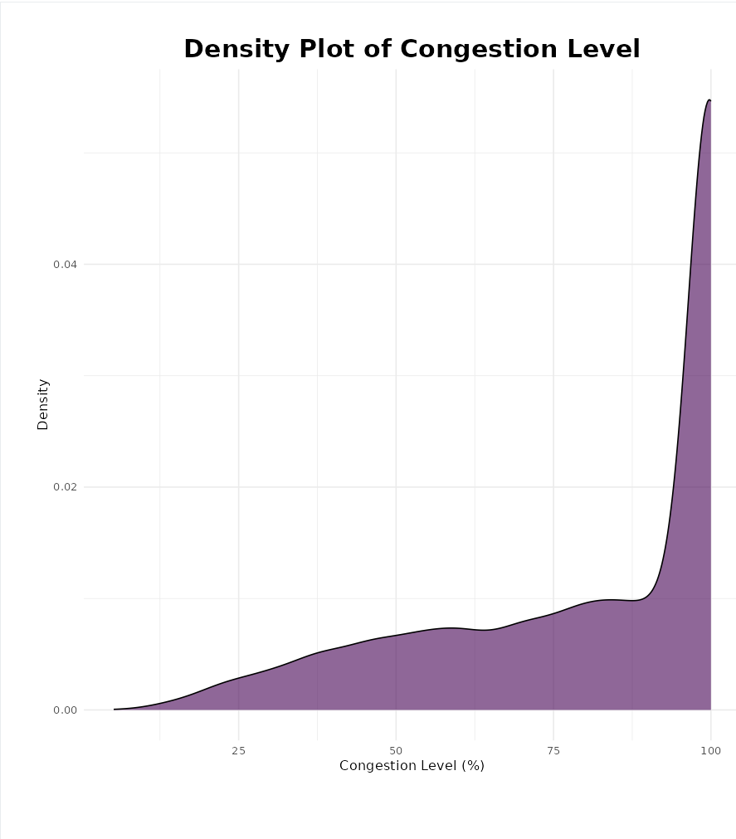
Exploration

Slide 6
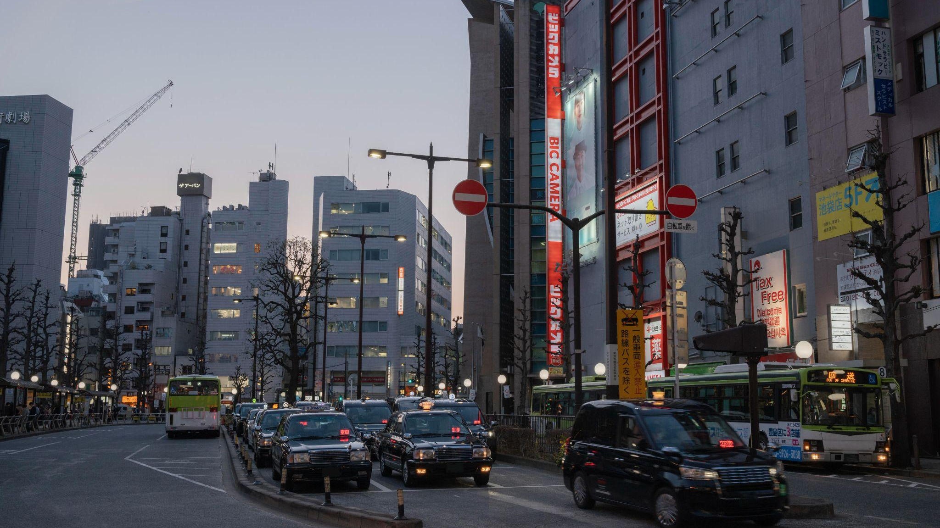
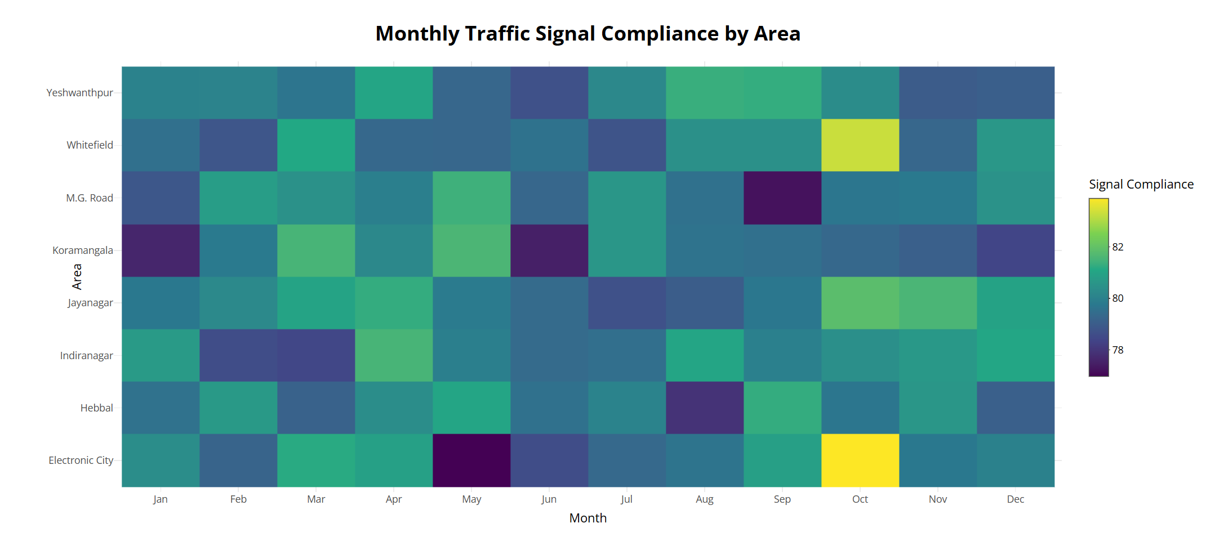
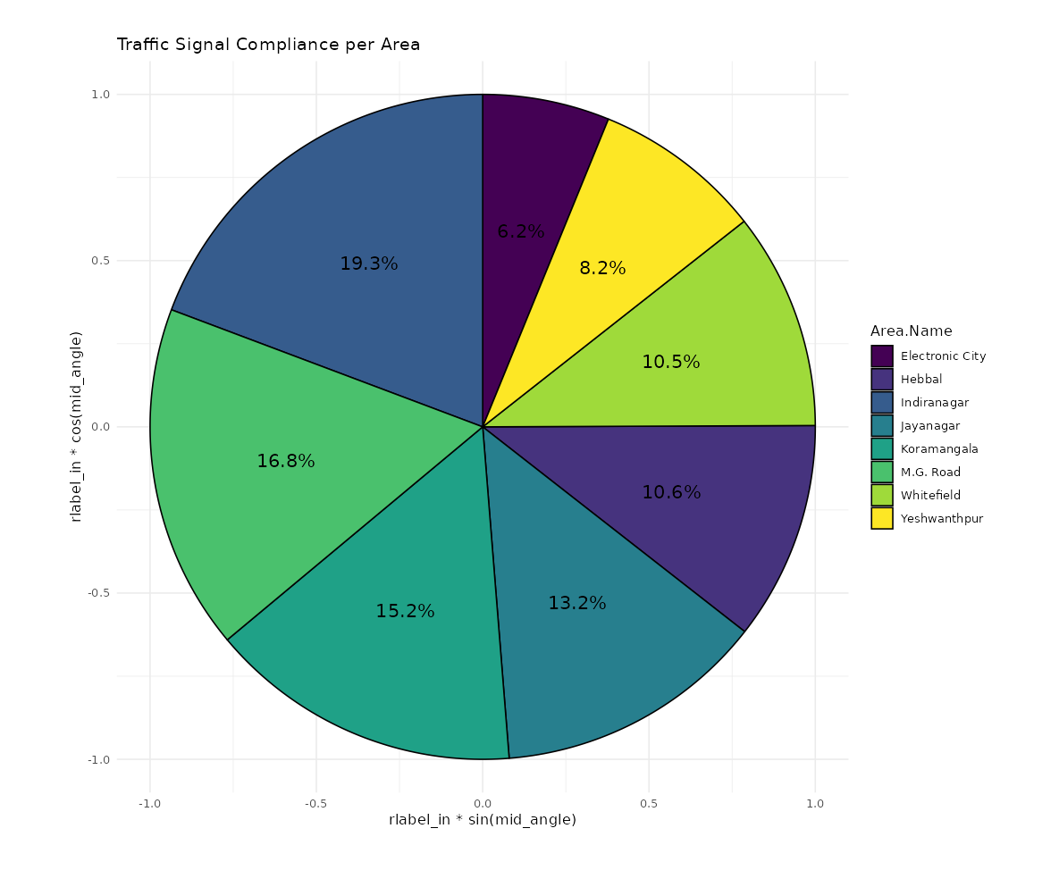
Compliance and Its Relationship with Traffic Performance

Slide 7
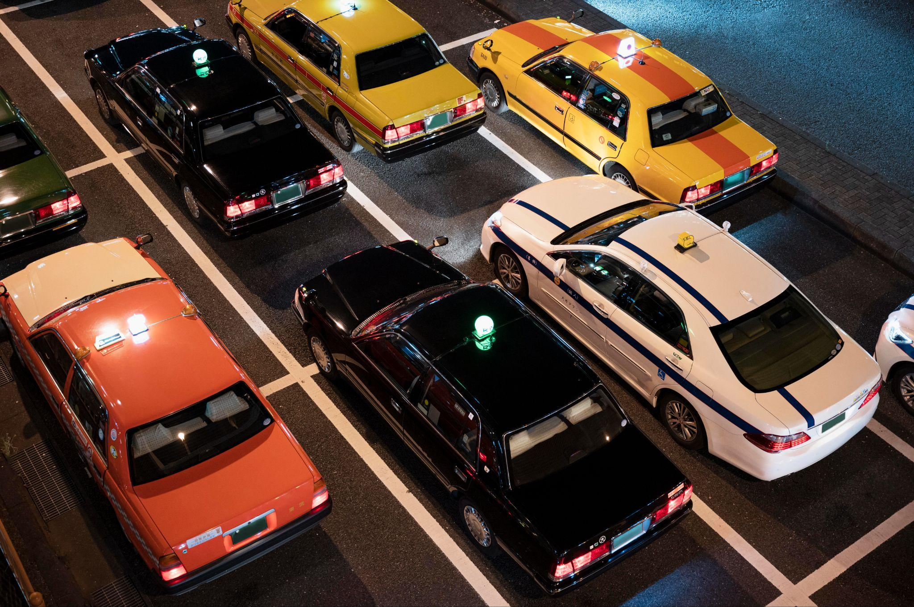
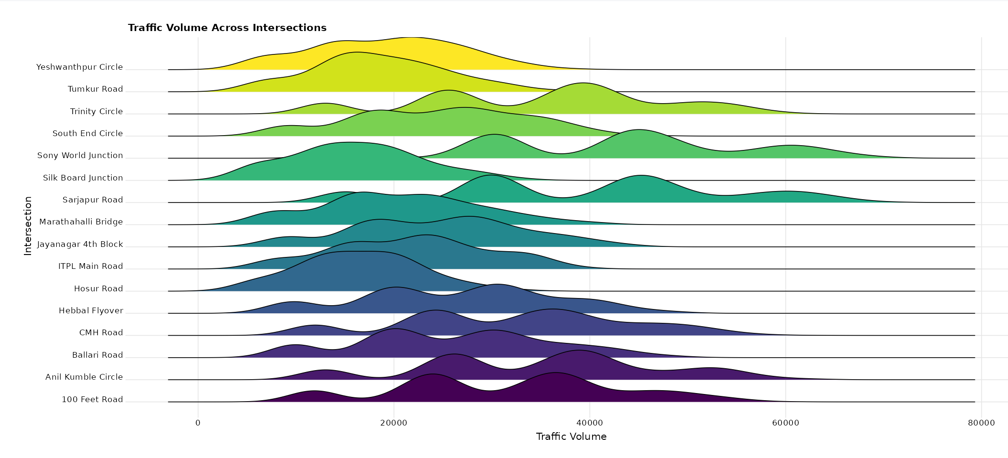
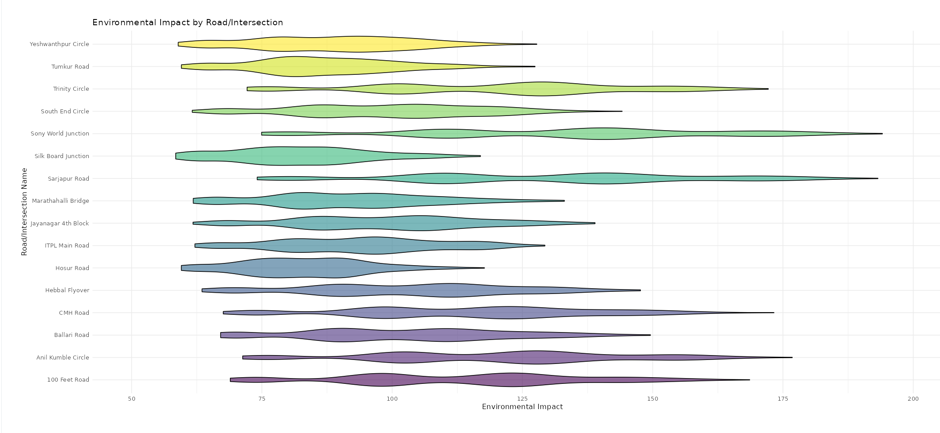
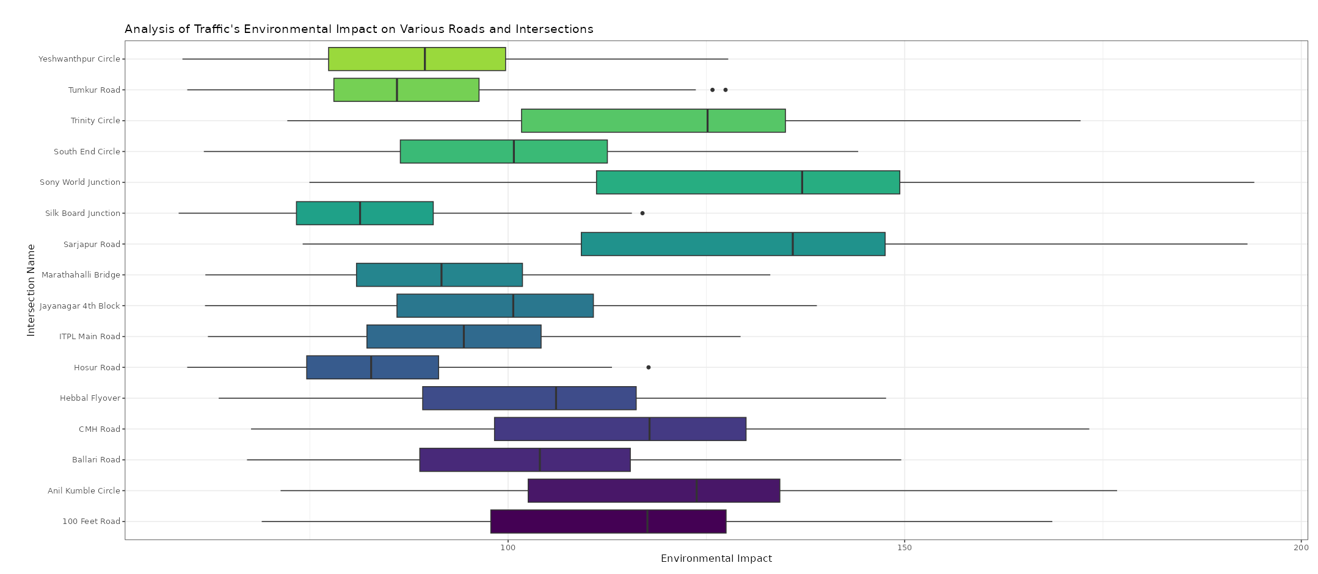
Traffic Volume Patterns
Treemap visualized intersections with heaviest traffic volume

Slide 8

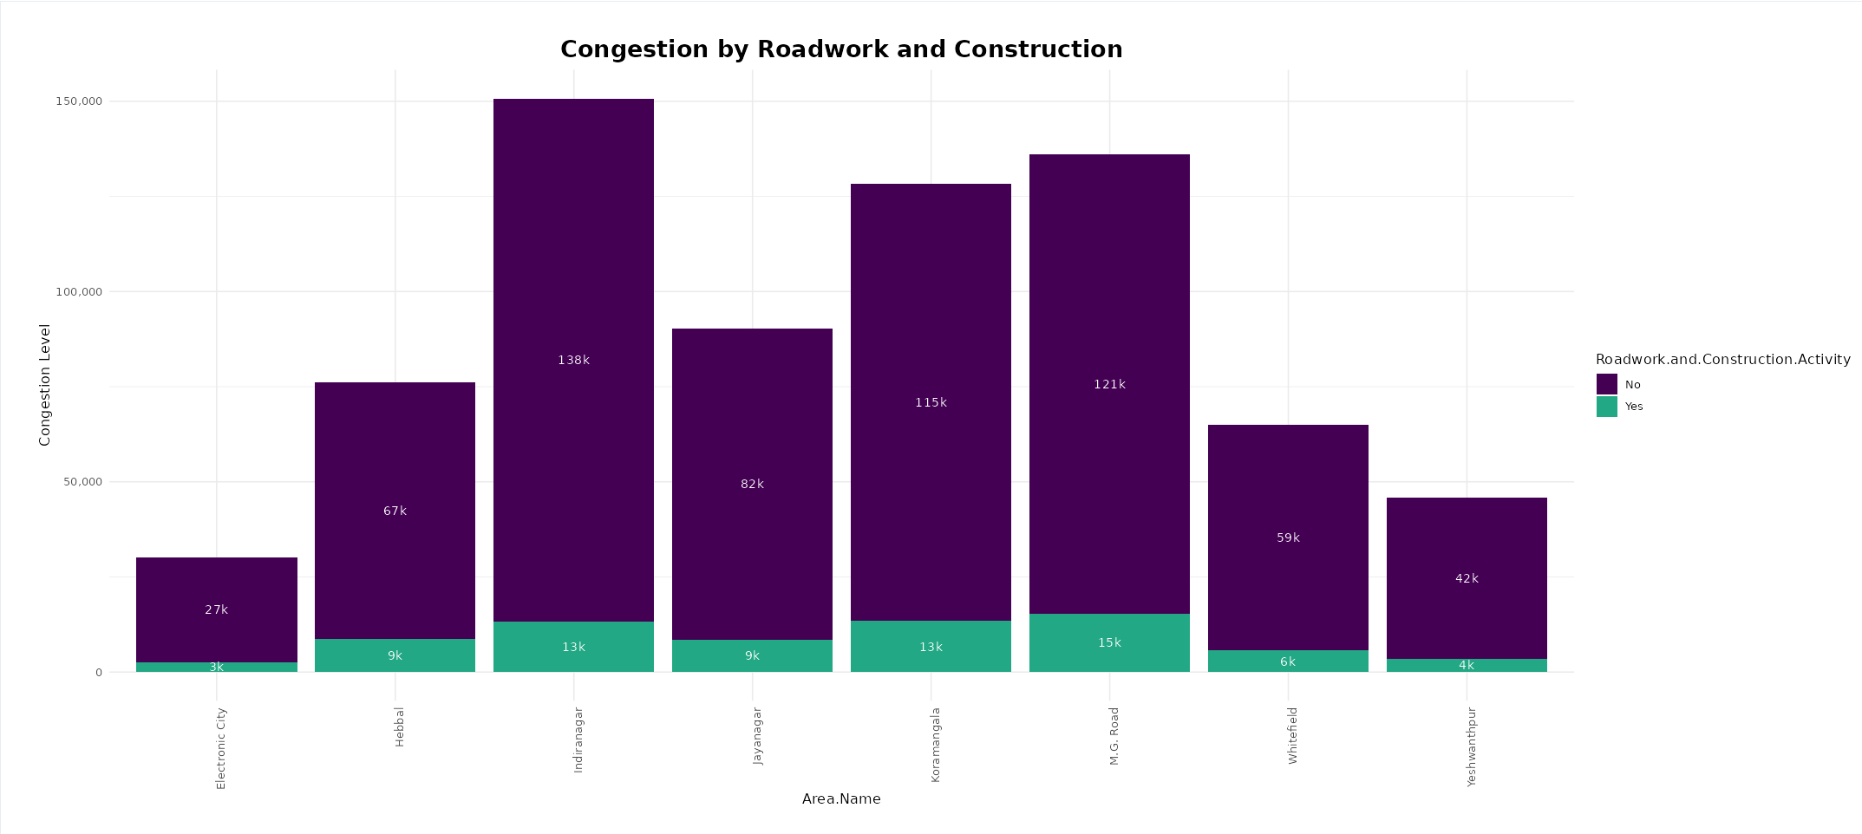
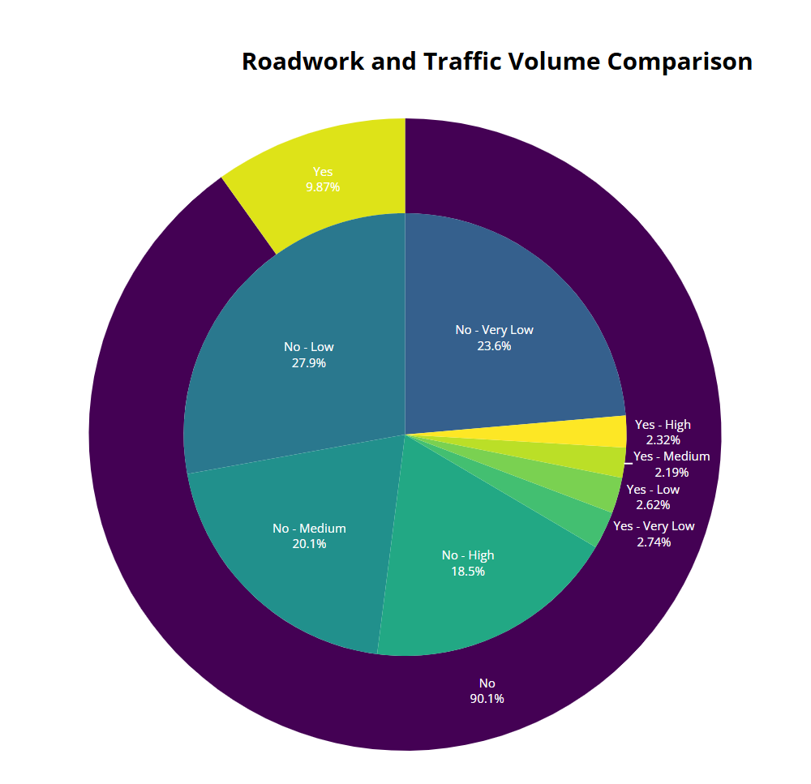
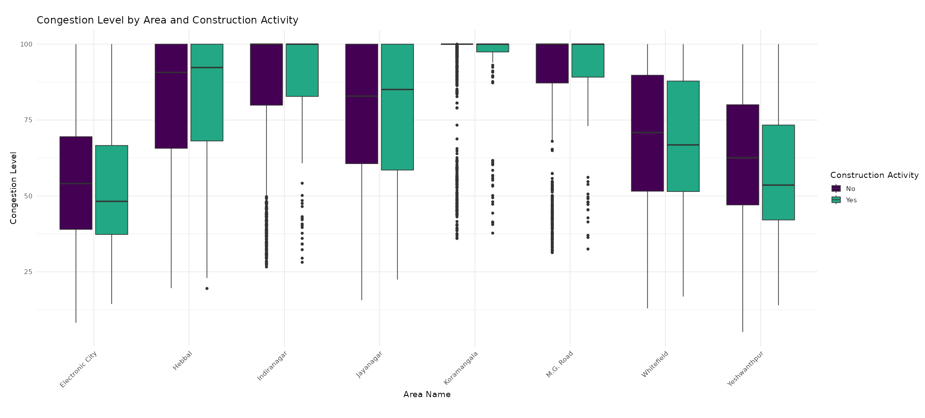
How Roadwork and Construction Affect Congestion

Slide 9

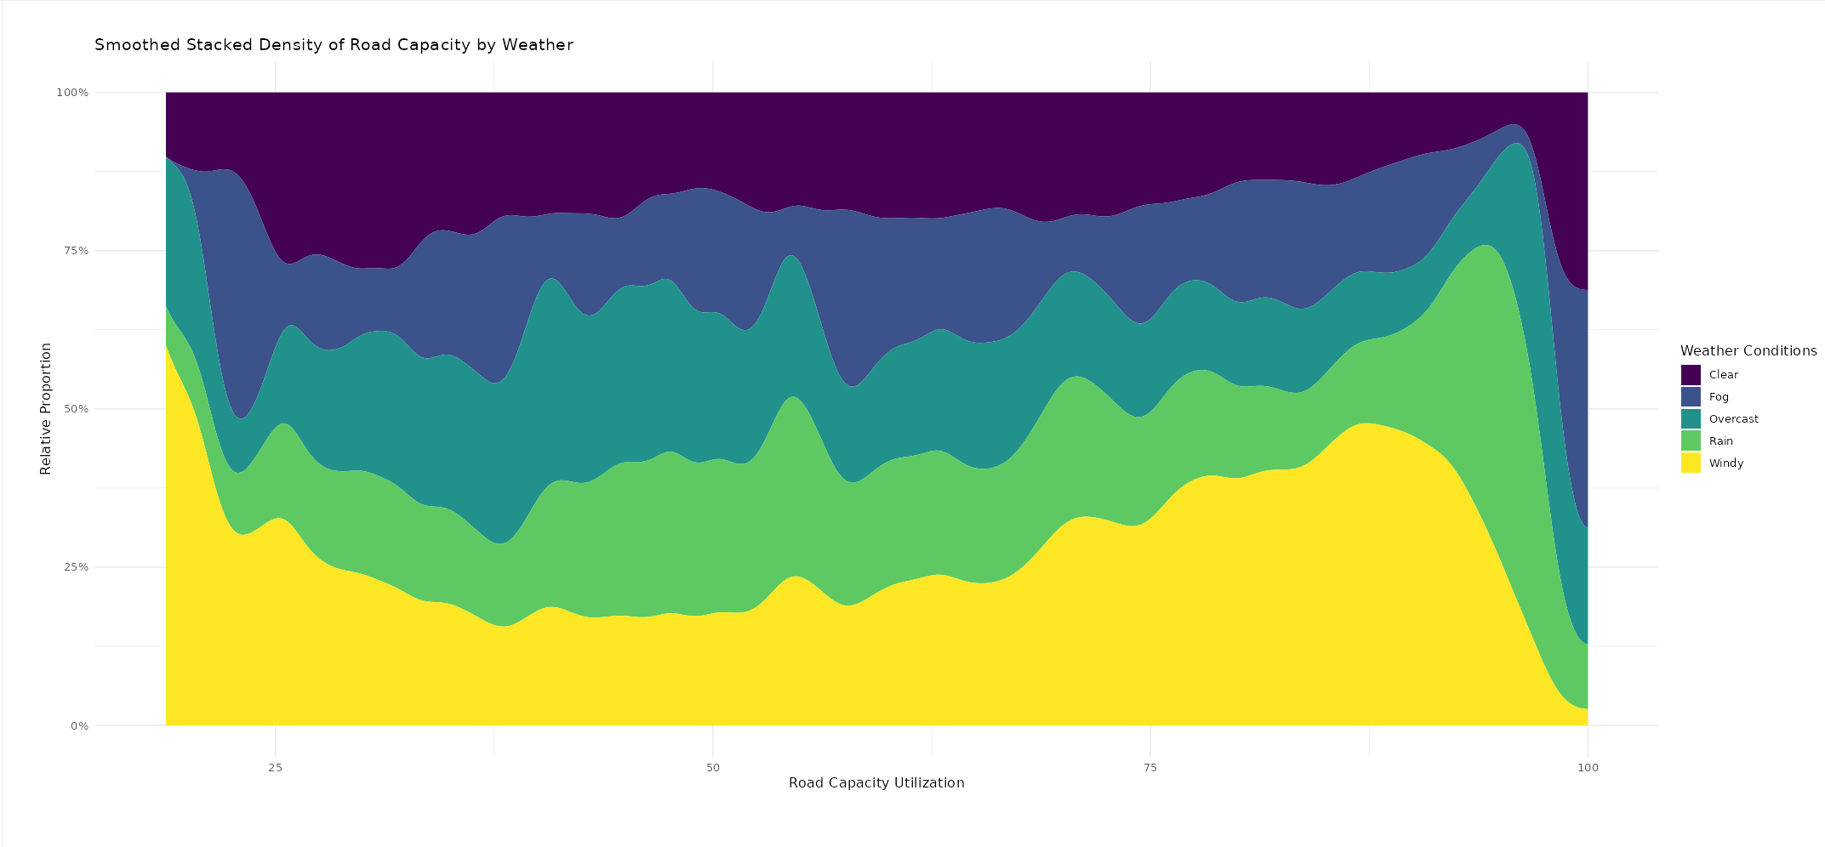
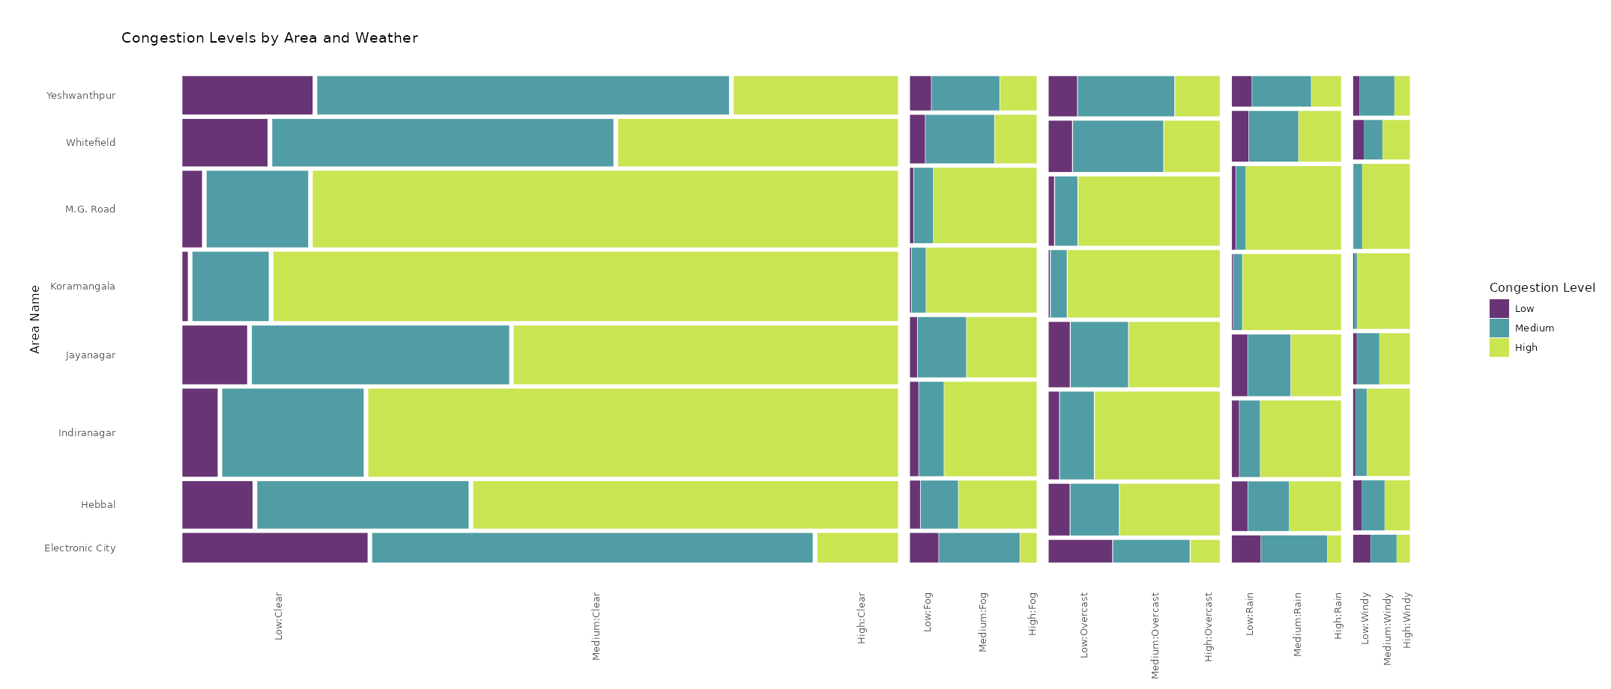
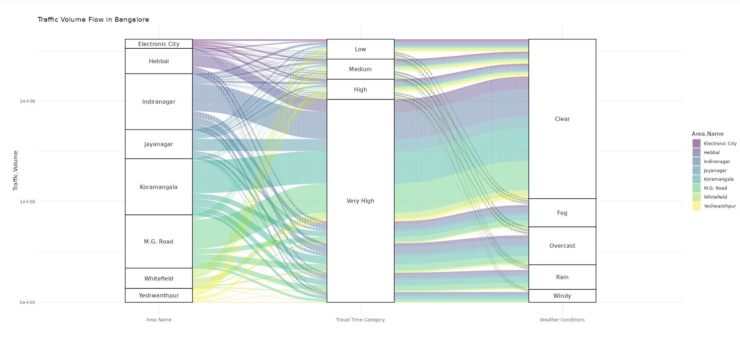
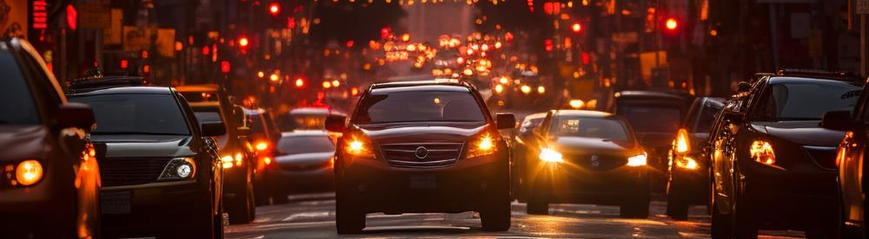
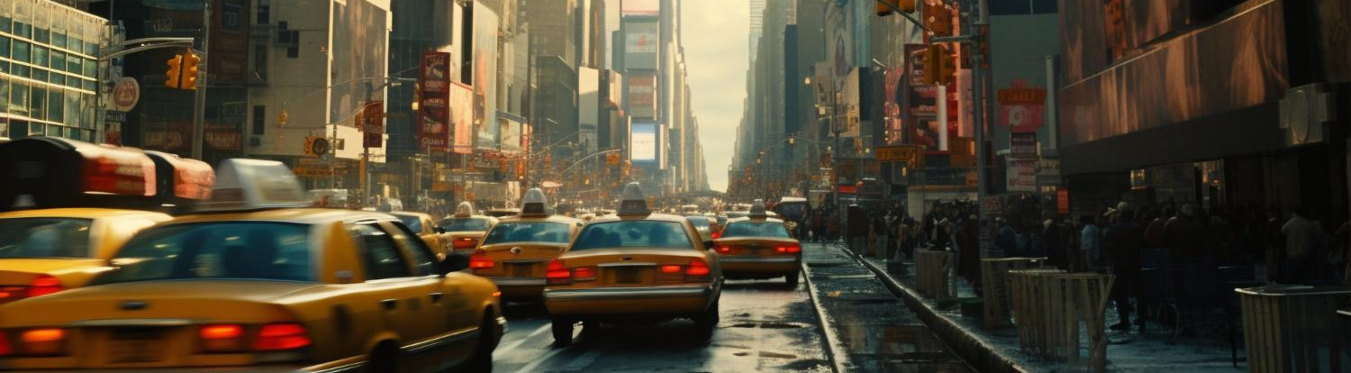
Impact of Weather Conditions

Slide 10

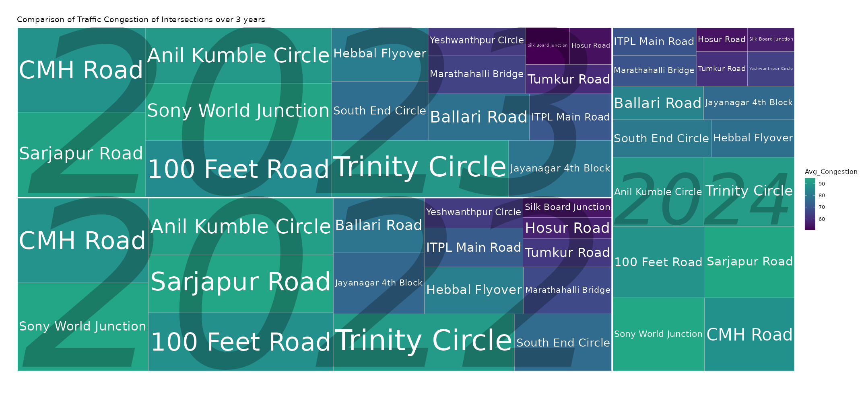
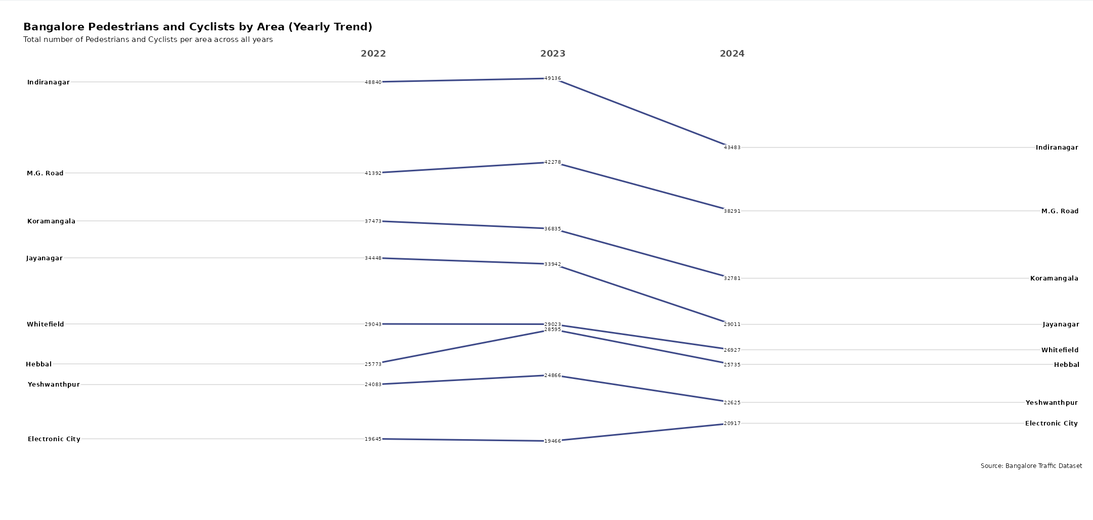
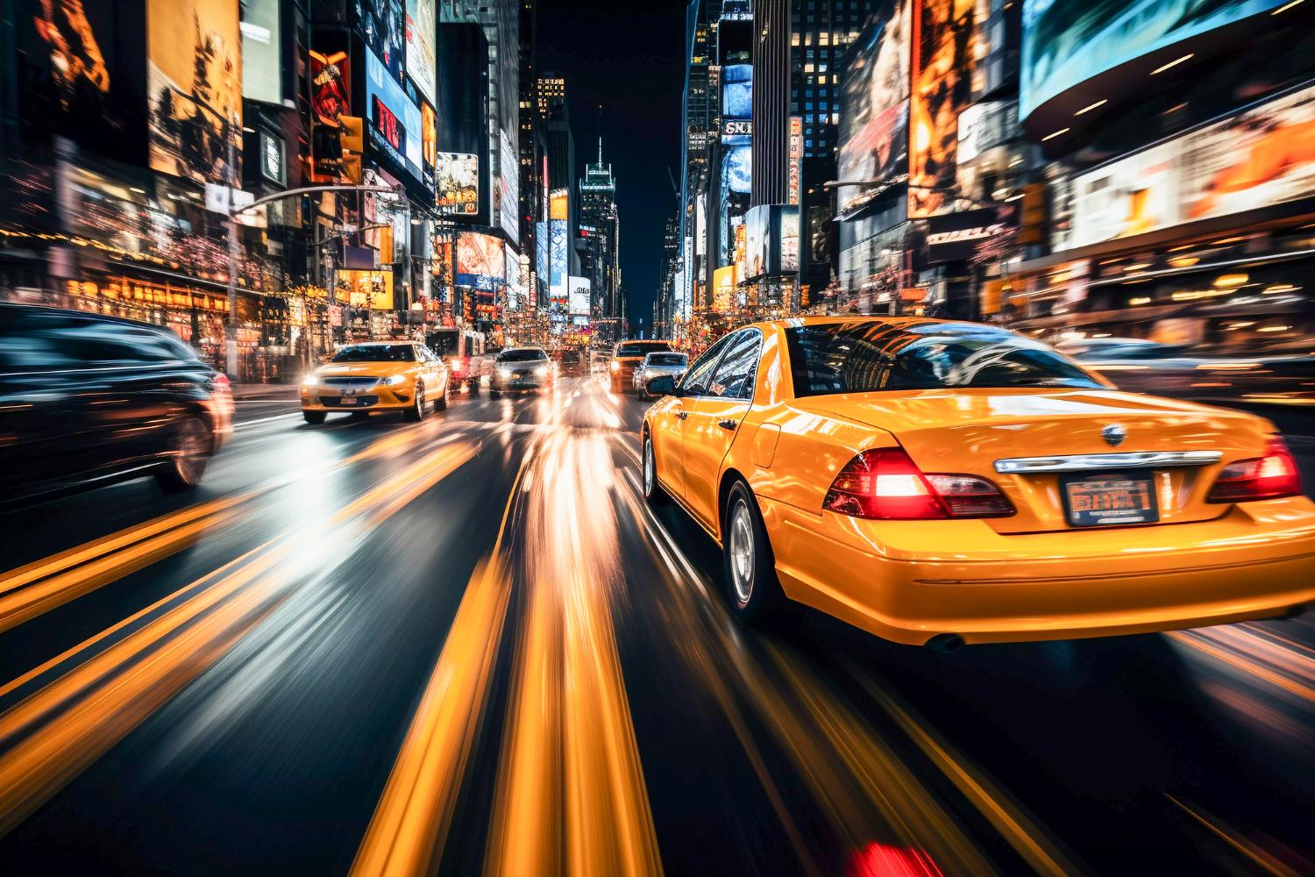
Year-on-Year Patterns and Emerging Trends

Slide 11

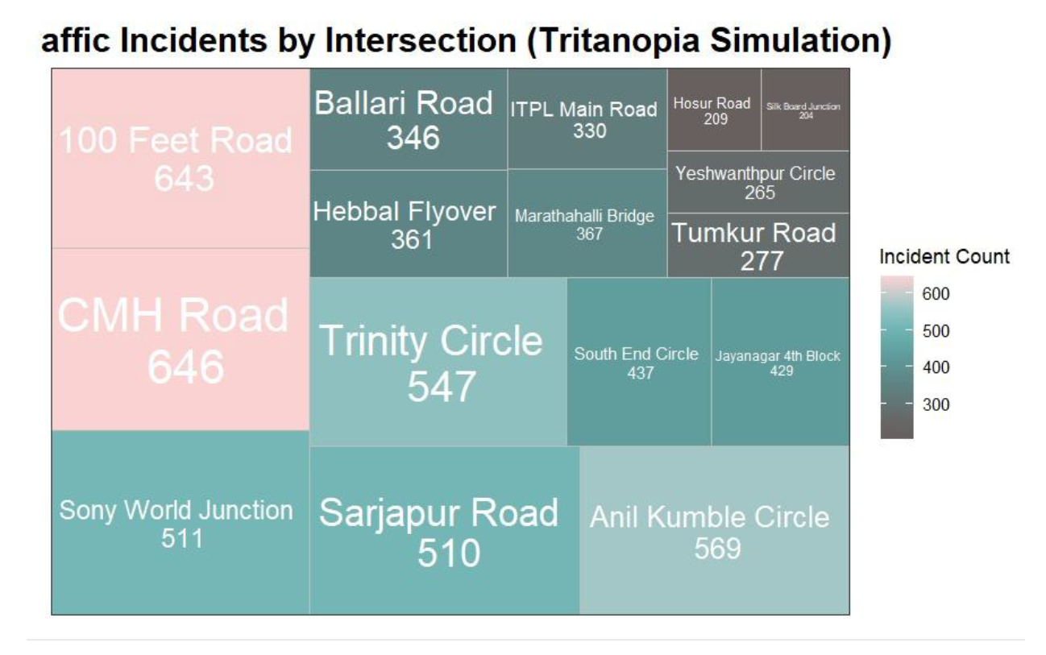
Future Plans
To improve accessibility, we plan to add a toggle button that switches between standard and colorblind-friendly palettes, ensuring visual insights remain clear for all users, including those with color vision deficiencies.

Slide 12
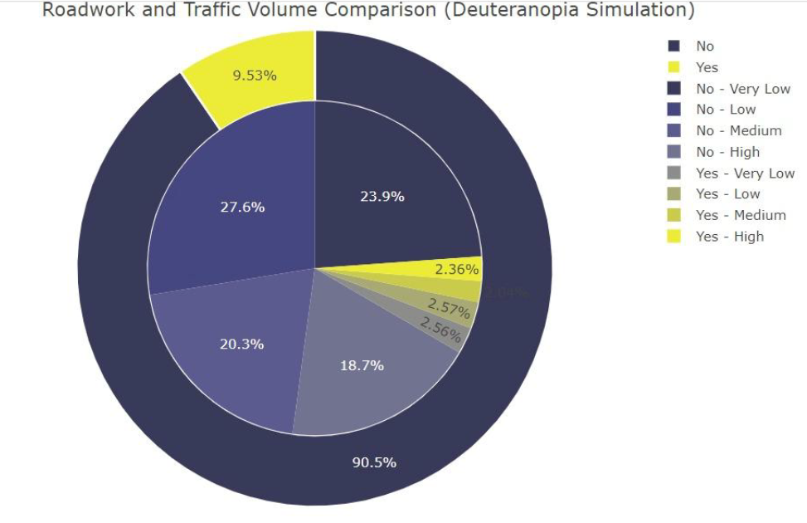
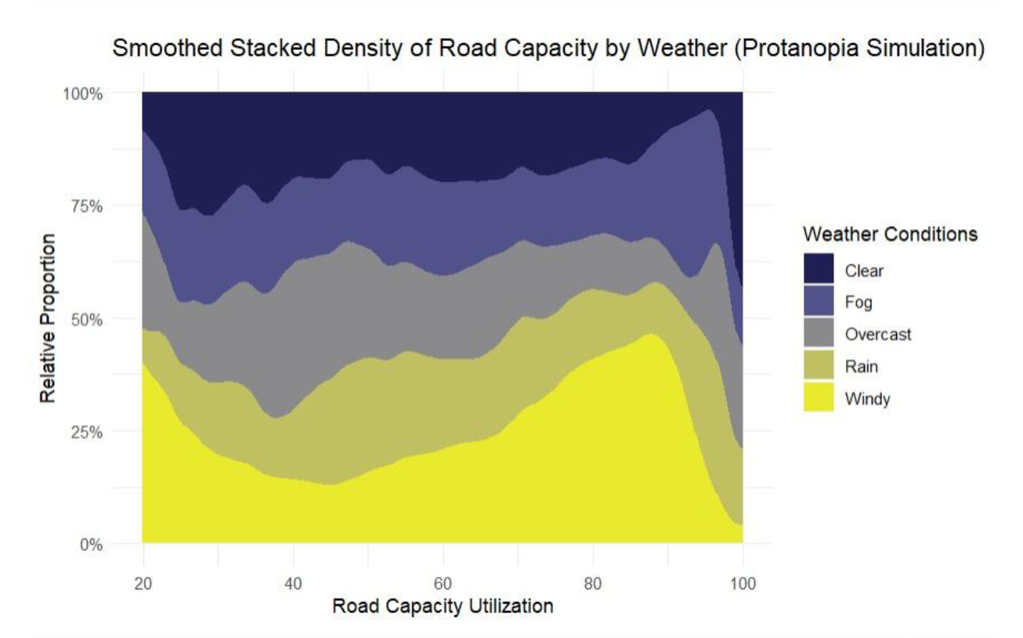
Future Plans

Slide 13
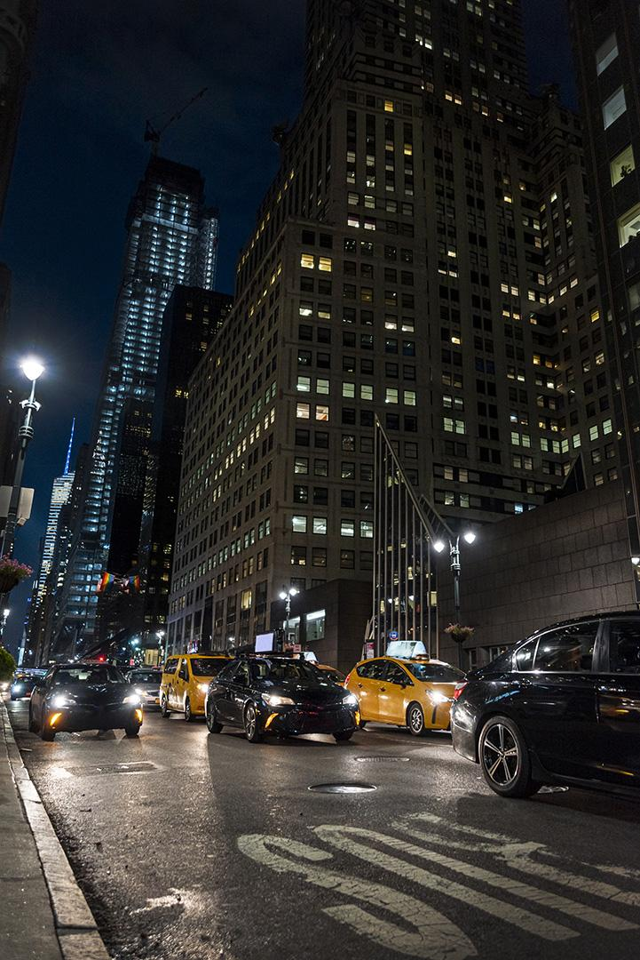
THANKS for listening!

